Slide 1

Introduction to Game Development (with Unity) Week 2: Understanding Unity in details
week2
Ozacar Kasim, PhD | Computer Engineering Department

Slide 2
Week 1: Summary
Week1 summary
Structure of C#
Syntax
Loops
Variables
Method
Class
Interface
Enum
OOP concepts in C#
Encapsulation
Inheritance
Polymorphism
Abstraction

Slide 3
SOLID principles
Week1 summary
These principles establish practices for developing software with considerations for maintaining and extending it as the project grows.
SOLID stands for:
S - Single-responsibility Principle
Each class should have only one reason to change.
O - Open-closed Principle
Code should be open for extension but closed for modification.
L - Liskov Substitution Principle
A subclass should be able to replace its parent class without breaking the system.
I - Interface Segregation Principle
A class should not be forced to implement methods it doesn’t use.
D - Dependency Inversion Principle
High-level modules should not depend on low-level modules. Both should depend on abstractions.

Slide 4
Table of Contents
Miscellaneous in Unity
Asset Store
Standard Assets
Import export Packages
Monobehaviour class
Awake(), Start()
Update(), FixedUpdate()
OnEnable(), OnDisable()
Unity Basics
Game
Scene
Inspector
Console
Assets
Building a game (deploy to target platform)
GUI (graphical user interface)
Camera
Rigidbody
Transform
Vector, Dot & Cross products,

Slide 5
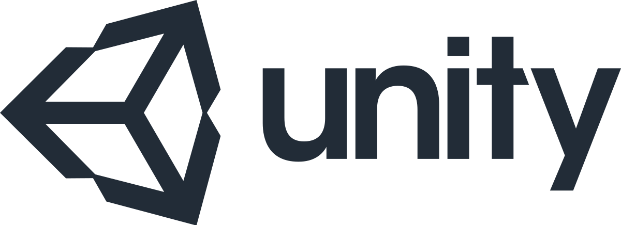
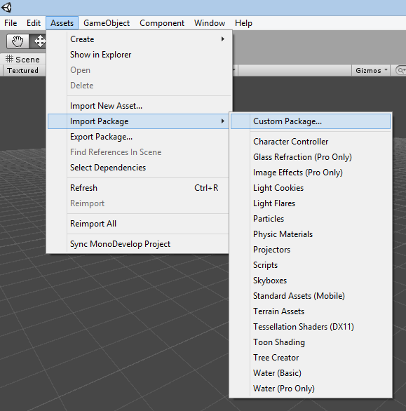
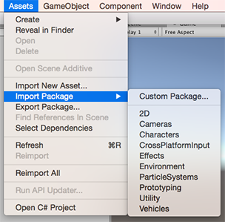
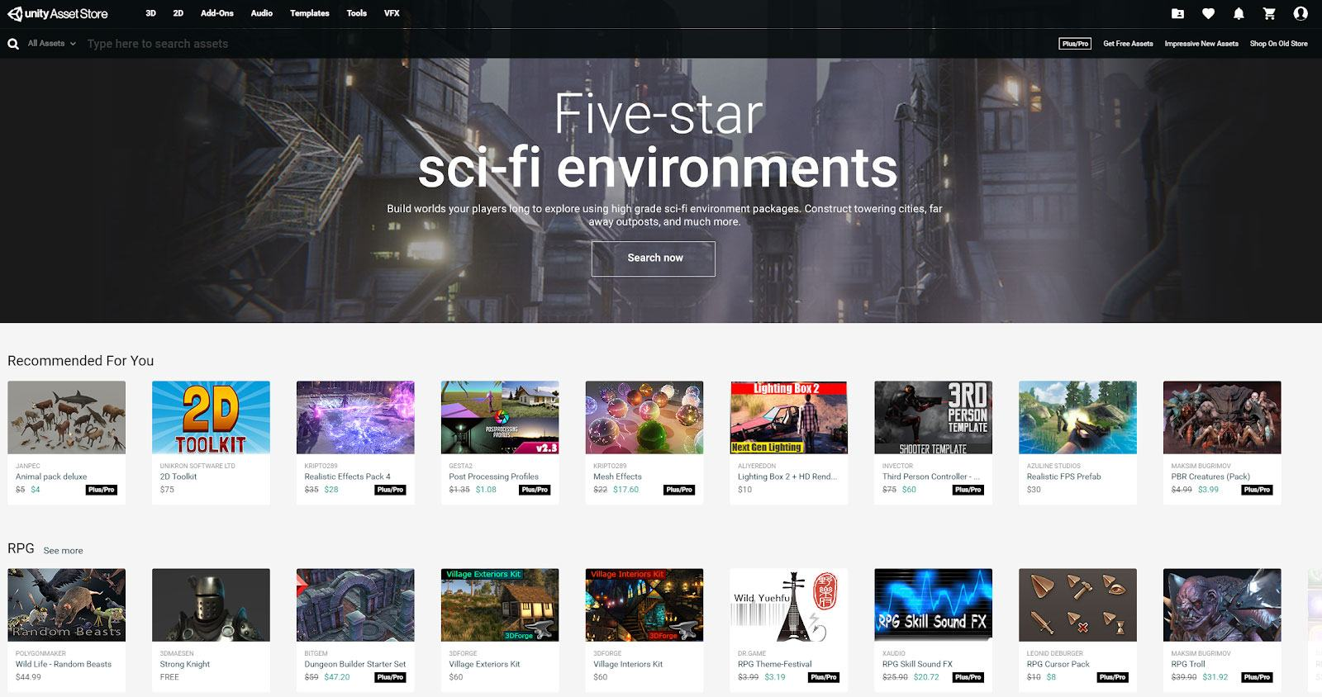
Miscellaneous in
Import export Packages
Standard Assets
Asset Store

Slide 6
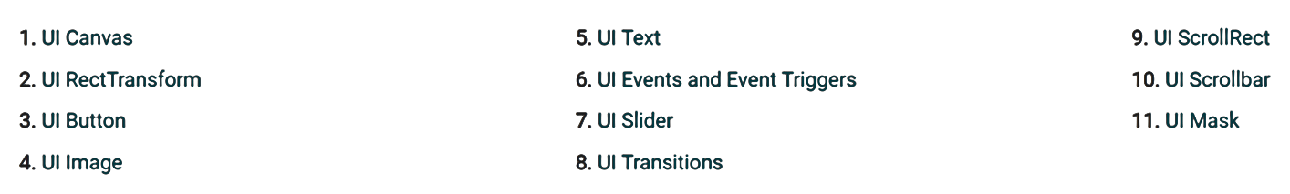
UI-User interface
The Canvas is the root component for rendering all UI objects in Unity.
The RectTransform is the positioning component for any UI element within a Canvas and is used to adjust positioning, anchoring, pivots and more.
What are UI Buttons made of and how do they function?
The UI Image component is the main graphic element of the UI system in Unity, and is used for everything from button and panel backgrounds to slider handles and speedometers!
The Text component, used to render text onscreen for various purposes such as labels, buttons, and other information.
Event System triggers things in code from your UI.

Slide 7
UI demo in Unity

Slide 8
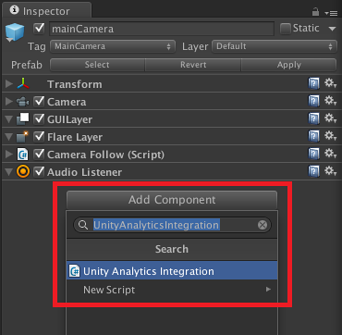
Adding a new behavior: “script” component
Debugging
Debug.Log(“ print ”);

Slide 9
Awake()
Awake is used to initialize any variables or game state before the game starts
using UnityEngine;
using System.Collections; public class ExampleClass : MonoBehaviour {
private GameObject target;
void Awake() {
target = GameObject.FindWithTag("Player");
}
}

Slide 10
Start()
Like the Awake function, Start is called exactly once in the lifetime of the script. However, Awake is called when the script object is initialized, regardless of whether or not the script is enabled
using UnityEngine; using System.Collections; public class ExampleClass : MonoBehaviour {
private GameObject target;
void Start()
{
target = GameObject.FindWithTag("Player");
}
}

Slide 11
Update()
Update() is called every frame as the game runs, output to the console continues repeatedly until I stop the game.
using UnityEngine; using System.Collections; public class ExampleClass : MonoBehaviour {
void Update()
{
transform.Translate(0, 0, Time.deltaTime * 1);
}
}

Slide 12
FixedUpdate()
This function is called every fixed framerate frame. FixedUpdate should be used when dealing with Rigidbody.
using UnityEngine; using System.Collections; public class ExampleClass : MonoBehaviour {
public Rigidbody rb; void Start() {
rb = GetComponent<Rigidbody>();
} void FixedUpdate() {
rb.AddForce(10.0f * Vector3.up);
}
}

Slide 13
OnGUI()
OnGUI is called for rendering and handling GUI events.
This means that your OnGUI implementation might be called several times per frame
using UnityEngine; using System.Collections; public class ExampleClass : MonoBehaviour {
void OnGUI() {
if (GUI.Button(new Rect(10, 10, 150, 100), "I am a button"))
print("You clicked the button!");
}
}

Slide 14
OnDisable()
This function is called when the behaviour becomes disabled () or inactive.
using UnityEngine; using System.Collections; public class ExampleClass : MonoBehaviour
{
void OnDisable() {
print("script was removed");
}
}

Slide 15
OnEnable()
This function is called when the behaviour becomes enabled () and active.
using UnityEngine; using System.Collections; public class ExampleClass : MonoBehaviour {
void OnEnable() {
print("script was enabled");
}
}

Slide 16
LateUpdate()
LateUpdate is called after all Update functions have been called. This is useful to order script execution. For example a follow camera should always be implemented in LateUpdate because it tracks objects that might have moved inside Update.
using UnityEngine; using System.Collections; public class ExampleClass : MonoBehaviour {
void LateUpdate() {
transform.Translate(0, Time.deltaTime, 0);
}
}

Slide 17
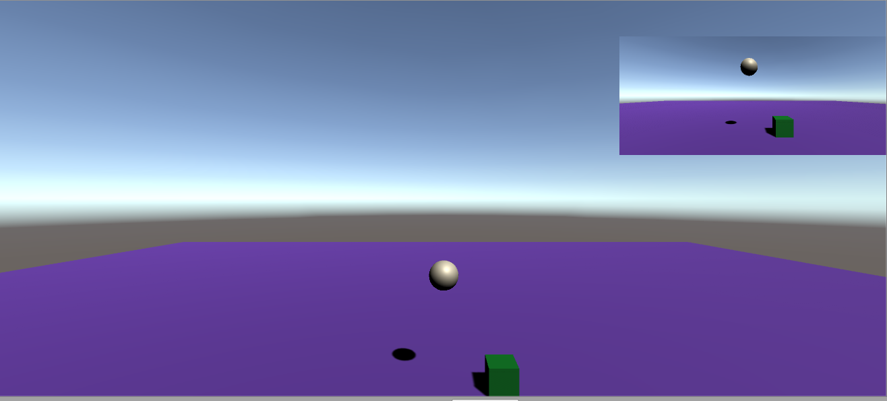
Working with Camera

Slide 18
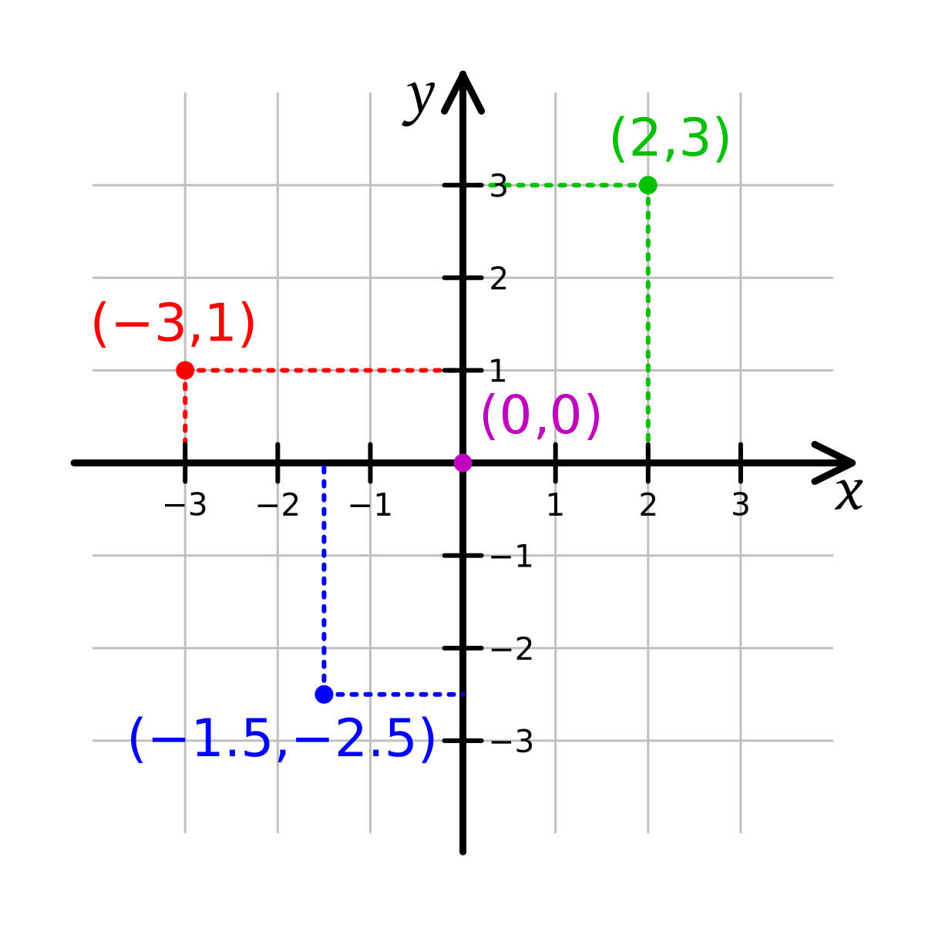
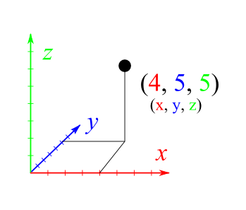
2D and 3D Points

Slide 19
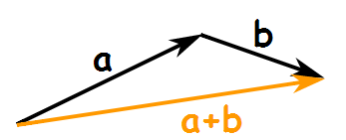
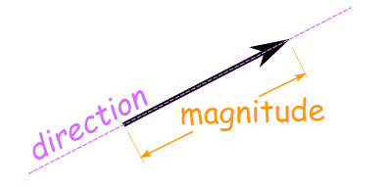
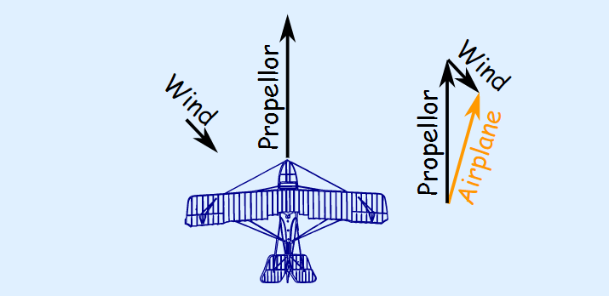
Vector2, Vector3
A vector has magnitude (how long it is) and direction:
We can add two vectors by joining them head-to-tail
a - b
a
a +b
-b
Example: A plane is flying along, pointing North, but there is a wind coming from the North-West.

Slide 20
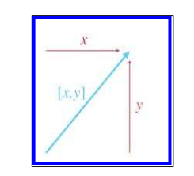
Vectors?
Geometrically speaking, a vector is a directed line segment that has magnitude and direction.
The magnitude of a vector is the length of the vector. A vector may have any nonnegative length.
The direction of a vector describes which way the vector is pointing in space.

Slide 21
The Relationship between Points and Vectors
Point
Vector
“points and vectors are conceptually different, but mathematically the same.”

Slide 22
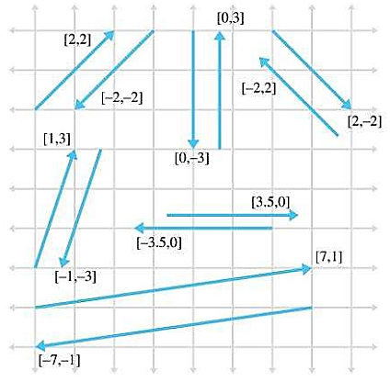
Negating a Vector

Slide 23
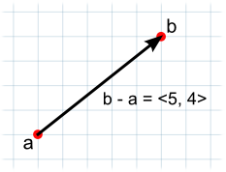
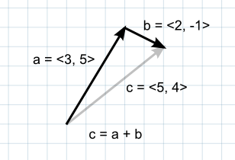
Addition, Subtraction
Addition
Subtraction
For example, to find a point 5 units above a location on the ground, you could use the following calculation:
Vector3 pointInAir = pointOnGround + new Vector3(0, 5, 0);

Slide 24
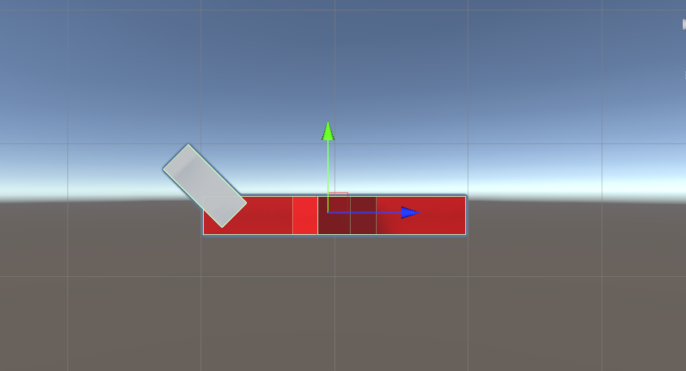




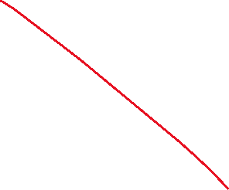







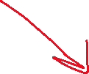



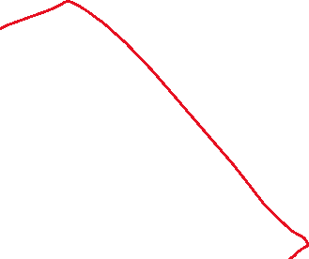



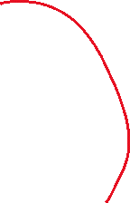
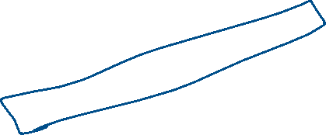

Slide 25
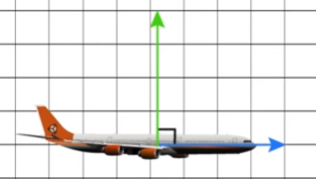
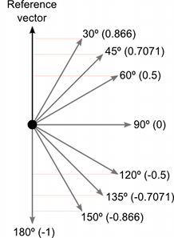
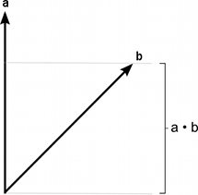
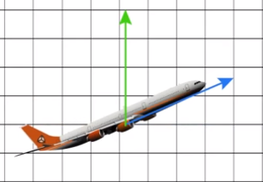
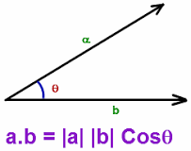
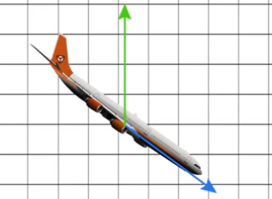
Dot product
Real world example
World.up
Two vectors can be multiplied using the "Dot Product“
The dot product takes two vectors and returns a scalar
Plane.forward
(Dot product)
Example : Vector3.Dot(transform.forward, hit.transform.forward)

Slide 26
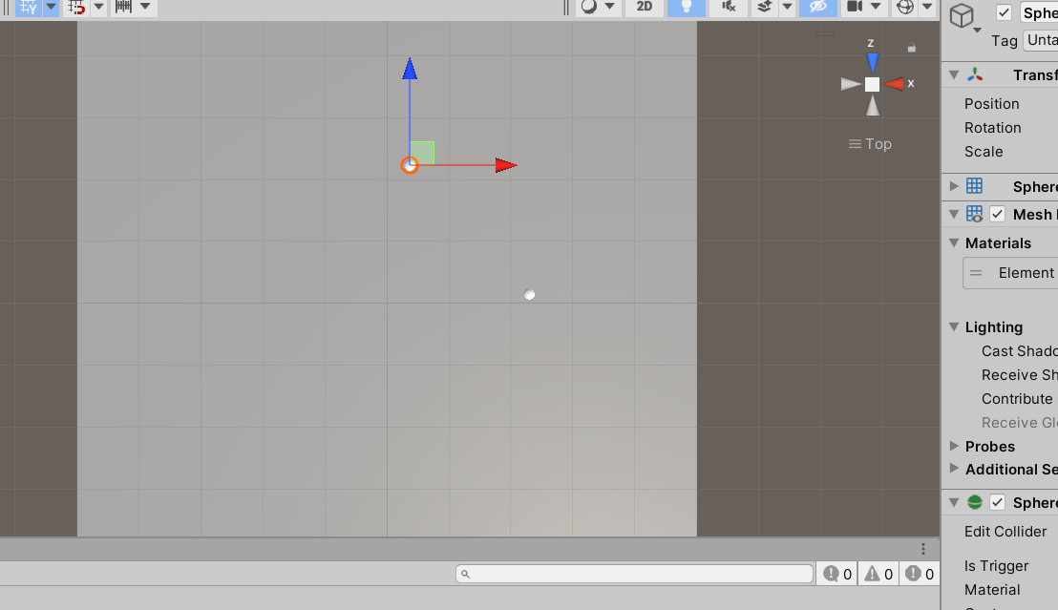


Slide 27
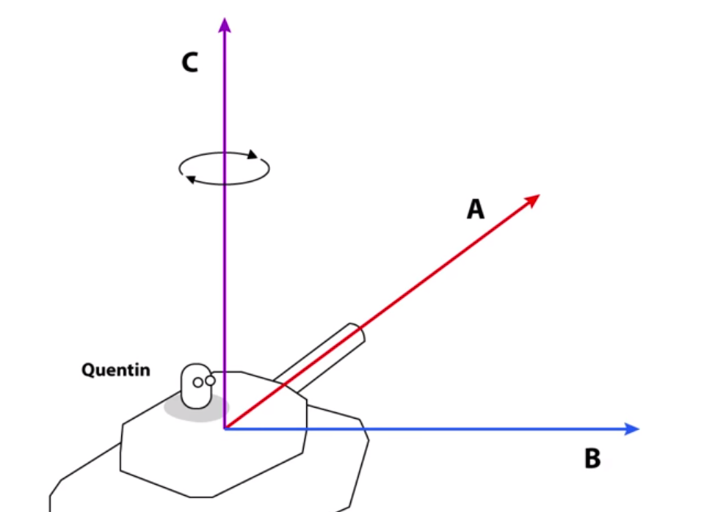
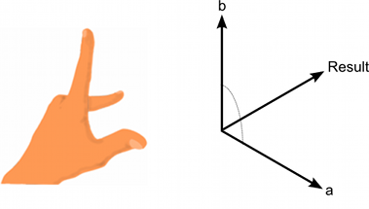
Cross product
Real world example
The cross product is only meaningful for 3D vectors. It takes two vectors as input and returns another perpendicular vector to each as its result.
Example: Vector3.Cross(transform.forward, hit.transform.forward)

Slide 28
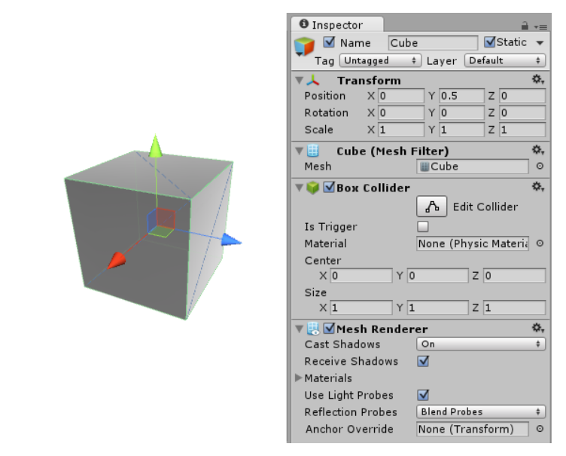
GameObject
GameObjects are the fundamental objects in Unity that represent characters, props and scenery.
They do not accomplish much in themselves but they act as containers for Components, which implement the real functionality.

Slide 29
Transform
Position, rotation and scale of an object.
using UnityEngine;
using System.Collections;
public class ExampleClass : MonoBehaviour
{
void Update()
{
foreach (Transform child in transform) {
child.position += Vector3.up * 10.0F;
}
}
}

Slide 30
Rigidbody
AddForce Adds a force to the Rigidbody.
Control of an object's position through physics simulation.
In a script, the FixedUpdate function is recommended as the place to apply forces and change Rigidbody settings

Slide 31
Colliders & Collision
Collider components define the shape of an object for the purposes of physical collisions. A collider, which is invisible, need not be the exact same shape as the object’s mesh.
OnCollisionEnter | OnCollisionEnter is called when this collider/rigidbody has begun touching another rigidbody/collider.
OnCollisionExit | OnCollisionEnter is called when this collider/rigidbody has stopped touching another rigidbody/collider.
OnCollisionStay | OnCollisionStay is called once per frame for every collider/rigidbody that is touching rigidbody/collider.

Slide 32
Trigger
OnCollisionEnter is called when two colliders hit. OnTriggerEnter is called when a collider enters a trigger (i.e. a collider with "IsTrigger" set).
OnTriggerEnter(Collider)
OnTriggerEnter is called when the Collider other enters the trigger.
OnTriggerStay(Collider)
OnTriggerStay is called almost all the frames for every Collider other that is touching the trigger.
OnTriggerExit(Collider)
OnTriggerExit is called when the Collider other has stopped touching the trigger.

Slide 33
OnCollisionEnter
OnCollisionEnter is called when this collider/rigidbody has begun touching another rigidbody/collider.
using UnityEngine;
public class ExampleClass : MonoBehaviour { void OnCollisionEnter(Collision collision)
{
foreach (ContactPoint contact in collision.contacts)
Debug.DrawRay(contact.point, contact.normal, Color.white); }
}

Slide 34
OnCollisionExit
OnCollisionEnter is called when this collider/rigidbody has stopped touching another rigidbody/collider.
using UnityEngine; using System.Collections; public class ExampleClass : MonoBehaviour {
void OnCollisionExit(Collision collisionInfo)
{
print("No longer in contact with " + collisionInfo.transform.name);
}
}

Slide 35
OnCollisionStay
OnCollisionStay is called once per frame for every collider/rigidbody that is touching rigidbody/collider
using UnityEngine; using System.Collections; public class ExampleClass : MonoBehaviour {
void OnCollisionExit(Collision collisionInfo)
{
print(collisionInfo.transform.name + “is staying" );
}
}

Slide 36
UI-User interface
The Canvas is the root component for rendering all UI objects in Unity.
The RectTransform is the positioning component for any UI element within a Canvas and is used to adjust positioning, anchoring, pivots and more.
What are UI Buttons made of and how do they function?
The UI Image component is the main graphic element of the UI system in Unity and is used for everything from button and panel backgrounds to slider handles and speedometers!
The Text component, used to render text onscreen for various purposes such as labels, buttons, and other information.
Event System triggers things in code from your UI.

